Slide 1
Optimising advanced cache needs with Redis
Performance and Scale Bangalore Meetup
Tanuj Vishnoi | 20th July, 2024

Slide 2

Hello!
Senior Software Engineer @Intuit.
Automating Virtual Expert Platform for Intuit Products.
IEEE Publication on ROS + Embedded AI.
Dyson Award publication.
Patent on Cognitive Wearables using ELL.
@vishnoitanuj

Slide 3
Quick Glance
Redis
The open source, in-memory data store used by millions of developers as a database, cache, streaming engine, and message broker.
High IoPs
Key-value store
Ephemeral store
Read and writes are less expensive and network optimised compared to traditional data store.

Slide 4
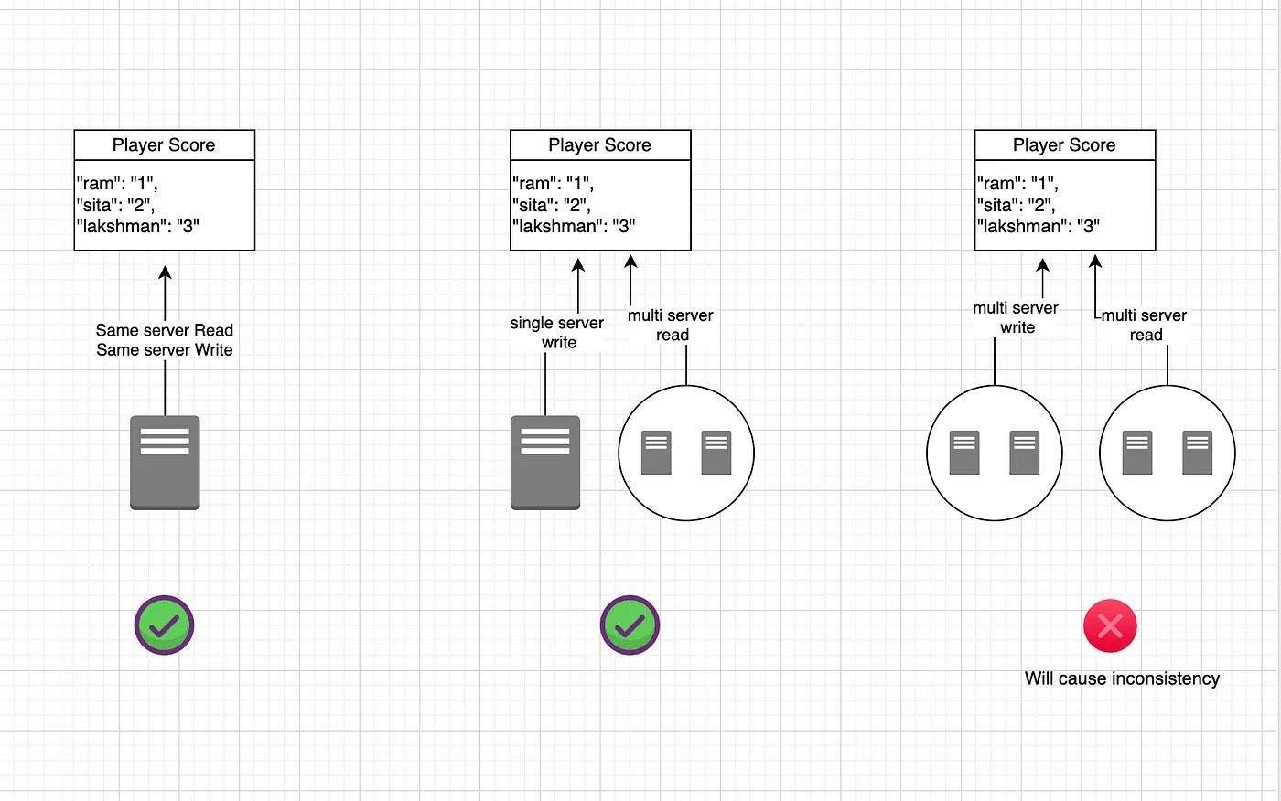
What’s this all about?
Single player game
Single instance multi player game
Multi instance multi player game

Slide 5
What’s this session all about?
Multi-tier relationship data.
Distributed caching.
High Throughput.
AKA: A distributed “volatile” object in Java.
Escape Map<String, String>
Redisson
Notes:
Hazelcast
Not handling big JVM head
Frequent disconnections
Self managed distributed cache.

Slide 6
Redisson
Map reduce abstraction
Web session clustering with Tomcat session managers and Spring sessions.
Distributed locks and synchronisers.
Supports most codes: Jackson, Avro, Snapy, etc.
Basics & Intro: https://redisson.org

Slide 7
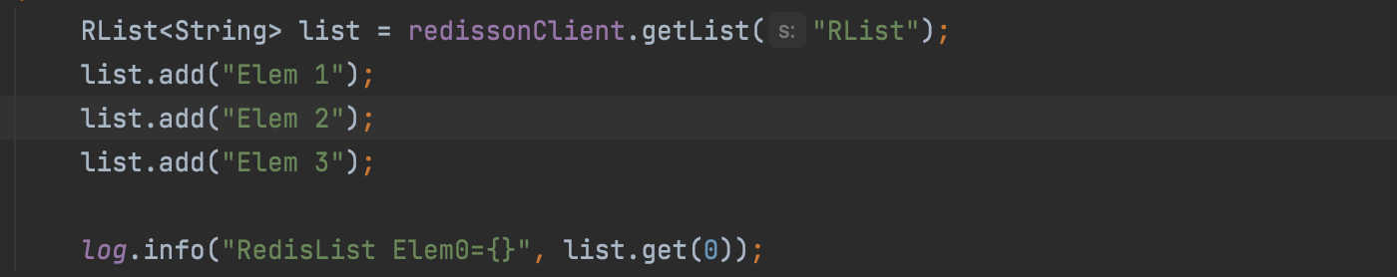
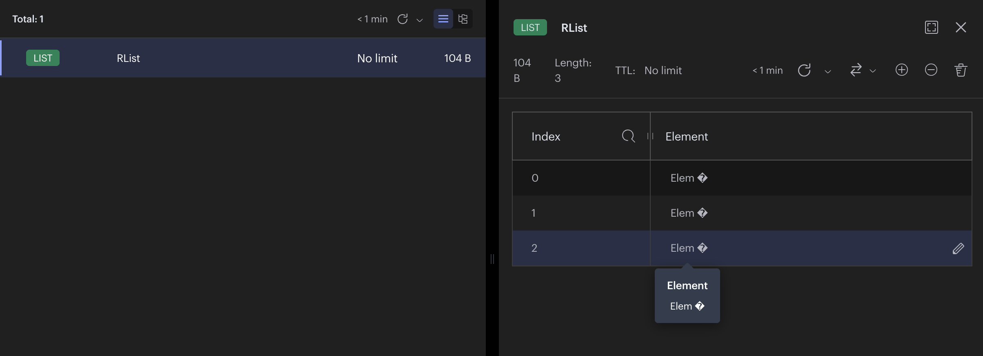
Redisson Data Types
List: List implementation in Redis

Slide 8
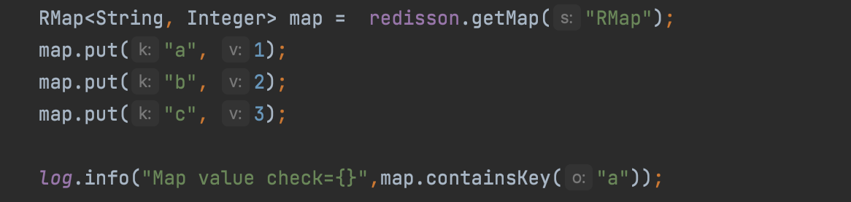
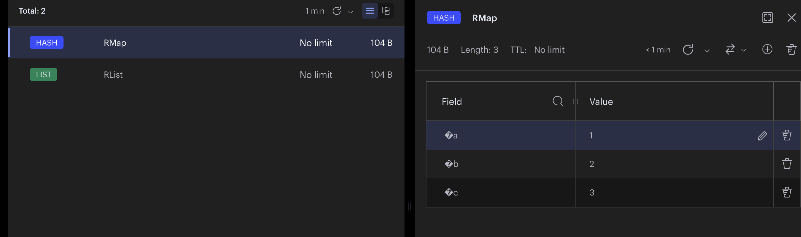
RMap
Map Implementation for Redis. Store elements in a bucket as map.

Slide 9
Use case at Intuit Expert Platform
Many dependent systems depend on experts’ day schedule.
For this we store schedules for the day in cache.
This schedules often get updated in case of expert shift, expert being called to front office work due to demand, etc. This is a perfect use of multi-write with high performance reads.
Another use case is logging current expert status for on demand metric calculations of current supply
Max-TPS: 220
Average TPS: 58
Cost reduction from Amazon Postgres by 58% (vacuum partitioning) and MTTQ and MTTW reduced by 50%.

Slide 10
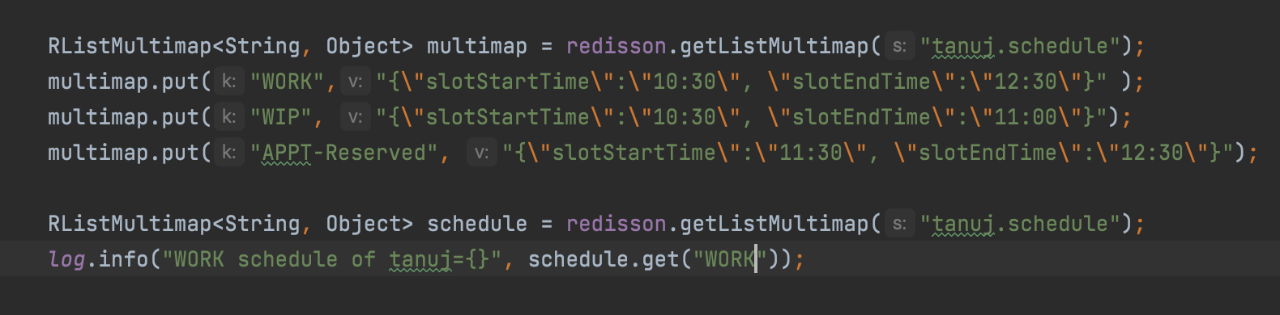
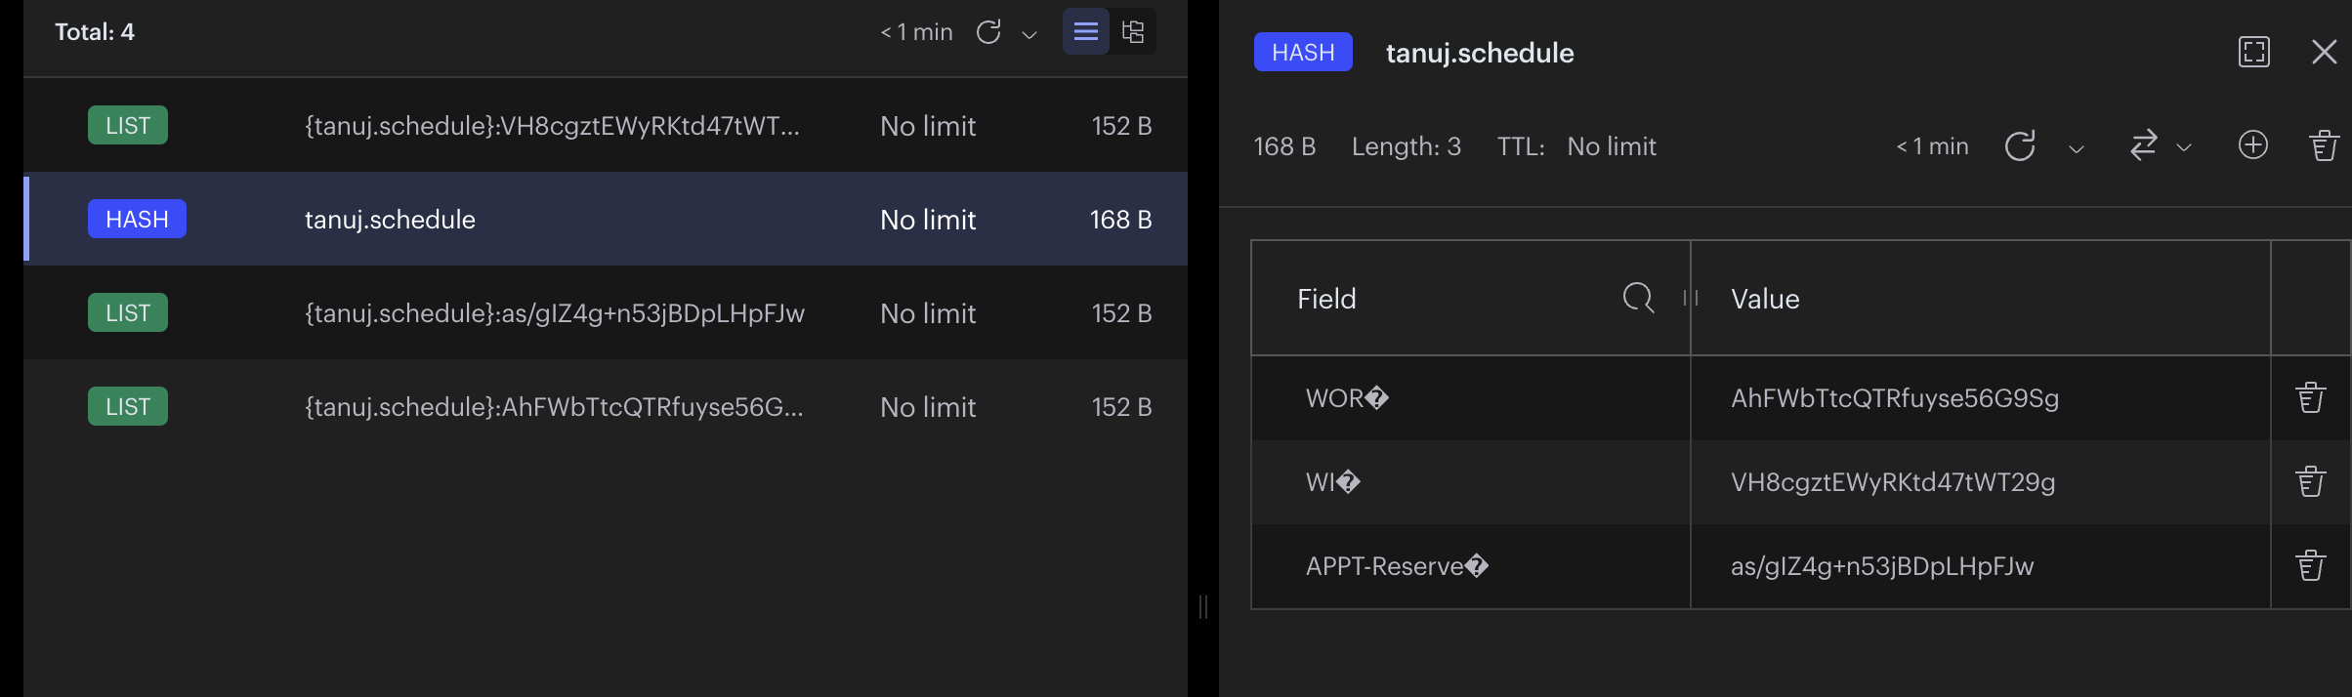
RListMultiMap
Combination of map + list. Helps store and retrieve information in O(1) using hash, abstracted from user.

Slide 11
Other data types
RedissonClient method name | Local cache | Data partitioning | Entry eviction | Ultra-fast read/write
getMap() open-source version | ❌ | ❌ | ❌ | ❌
getMapCache() open-source version | ❌ | ❌ | scripted | ❌
getMapCacheNative() open-source version | ❌ | ❌ | native | ❌
getLocalCachedMap() open-source version | ✔️ | ❌ | ❌ | ❌
getMap() Redisson PRO version | ❌ | ❌ | ❌ | ✔️
getMapCache() Redisson PRO version | ❌ | ❌ | scripted | ✔️
getMapCacheNative() Redisson PRO version | ❌ | ❌ | native | ✔️
getMapCacheV2() available only in Redisson PRO | ❌ | ✔️ | advanced | ✔️
getLocalCachedMap() Redisson PRO version | ✔️ | ❌ | ❌ | ✔️
getLocalCachedMapCache() available only in Redisson PRO | ✔️ | ❌ | scripted | ✔️
getLocalCachedMapCacheV2() available only in Redisson PRO | ✔️ | ✔️ | advanced | ✔️
getClusteredMap() available only in Redisson PRO | ❌ | ✔️ | ❌ | ✔️
getClusteredLocalCachedMap() available only in Redisson PRO | ✔️ | ✔️ | ❌ | ✔️
getClusteredMapCache() available only in Redisson PRO | ❌ | ✔️ | scripted | ✔️
getClusteredLocalCachedMapCache() available only in Redisson PRO | ✔️ | ✔️ | scripted | ✔️
RBucket
RSet
RSetCache, RClusteredSet
RMapCache, RLocalCachedMap, RClusteredMap
Notes:
RLocalCachedMap: Map object with local entry cache support. Suitable for maps which used mostly for read operations and network roundtrip delays are undesirable.

Slide 12
Distributed Locks
Redis based distributed reentrant Lock object for Java and implements Lock interface.
Uses pub/sub channel to notify other threads across all Redisson instances waiting to acquire a lock.
Maintains lock watchdog to prevent forever hanging locks.

Slide 13
Different types of Lock
RLock: Java Semaphore
Fair Lock: Acquires lock in same order as requested.
MultiLock: Group RLocks for object specific locks.
ReadWriteLock: Multiple read lock owners & one write lock owner
SpinLock: For high tps locks. Uses exponential backoffs and retry.
ShedLock: Particularly used for scheduling in a distributed system.
Other types of locks: https://github.com/redisson/redisson/wiki/8.-Distributed-locks-and-synchronizers
Notes:
RLock: It means only lock owner thread can unlock it otherwise IllegalMonitorStateException

Slide 14

Thanks 😄
Feel free to hit me
With QUESTION(s)
Twitter: vishnoitanuj
Linkedin: in/tanuj-vishnoi
Mail: tanujvishni1306@gmail.com
Github: vishnoitanuj/redis-demo
Tanuj Vishnoi | Intuit Inc.

